Slide 1
Module 2: Application Migrations
How To Assess, Categorise And Choose Applications To Migrate To AWS

Slide 2
Activity 2-1 (10 mins)
Revisit the application briefing paper on AnyCompany Fashion Ltd (AFL)

Slide 3
How To Get Started
At AWS we have several teams that can help you determine the right workloads/approach for migrating to cloud:
Sales Solution Architects
Professional Services
Business Development
Partners (Plus marketplace solutions)
There is no one-size fits all approach

Slide 4
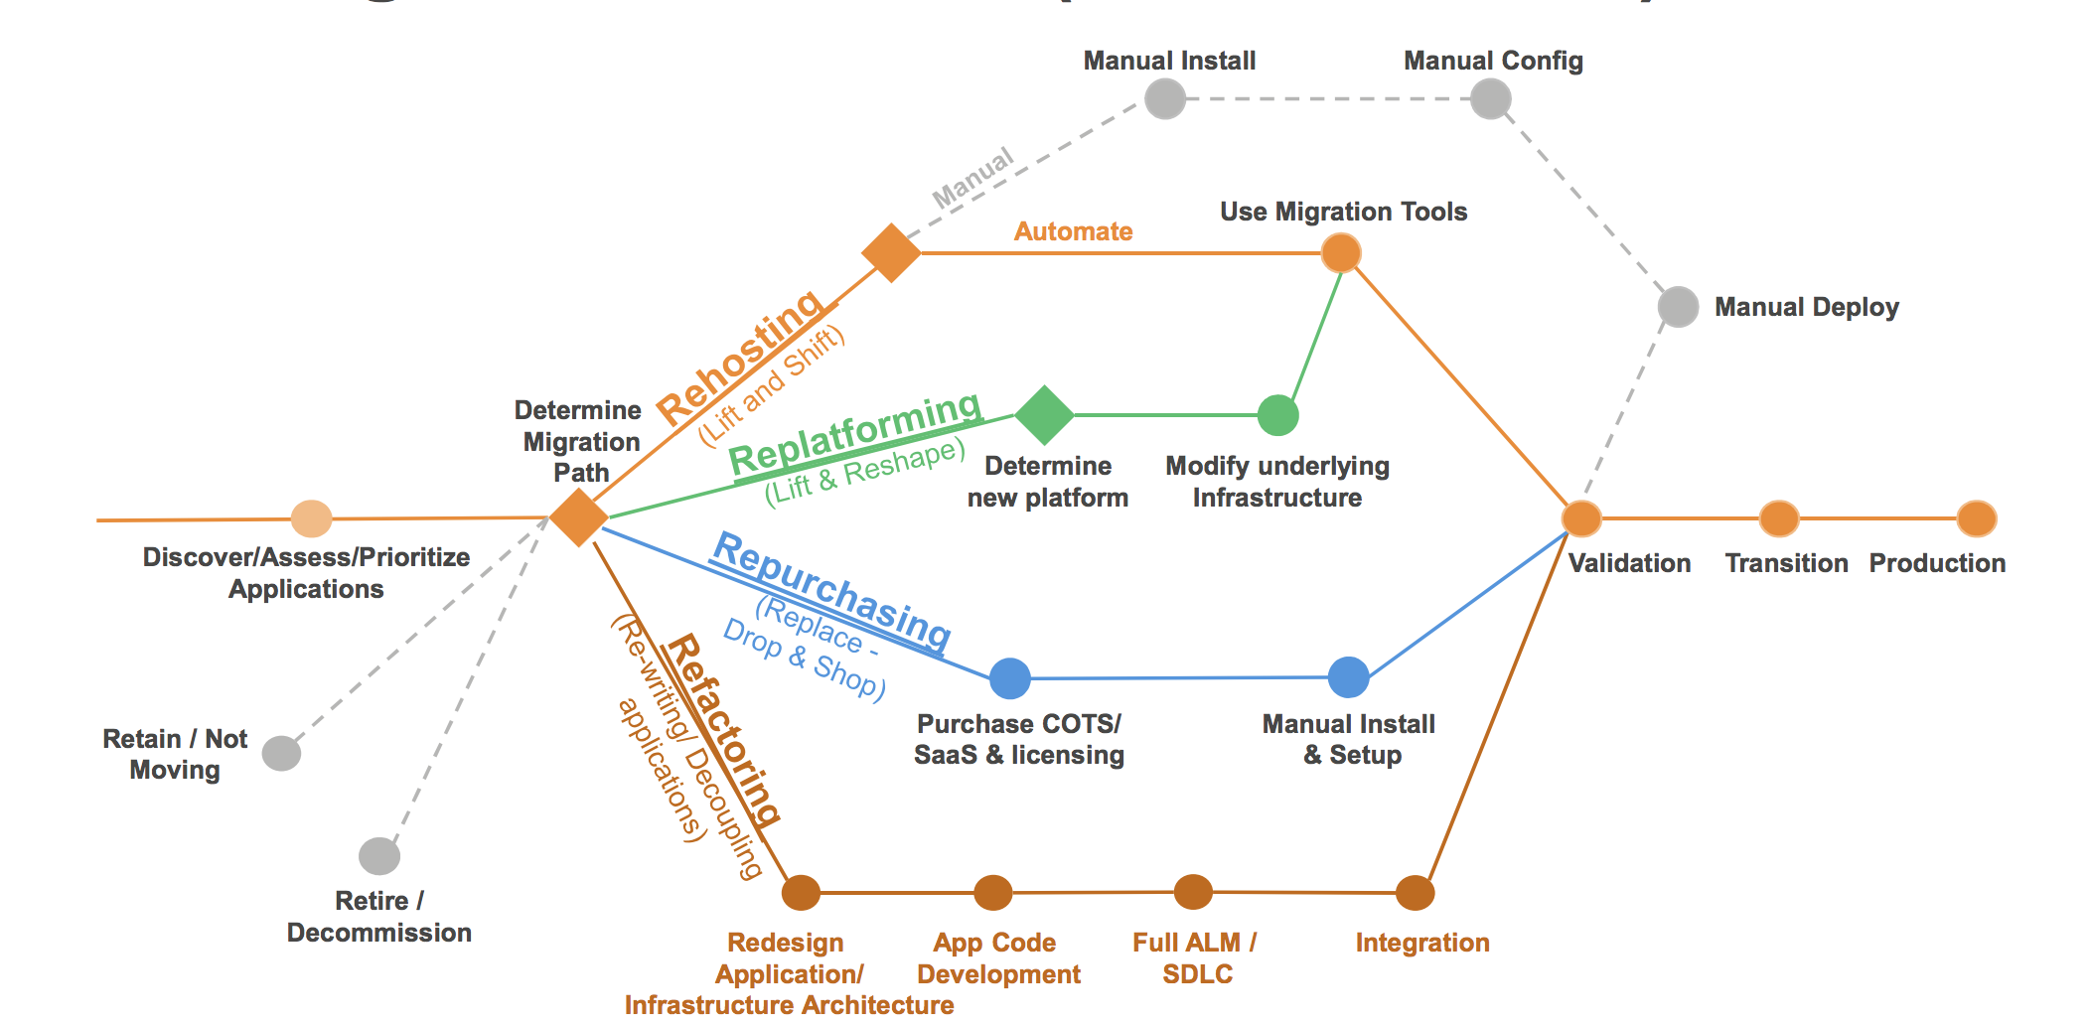
But We Do See Patterns

Slide 5
Here’s Some More Patterns
Approach | Benefit | Challenge
Virtual Machine Import | East to do bulk migration using VM Import or tools from the AWS Marketplace | Garbage in, garbage out
Manual Clean Install | Often quickest way to deploy the app one-time | Prone to error
Automated Deployment | Cloud attributes are easier to attain | A level of application maturity is needed
Rebuild | Cloud native applications can take full use of AWS benefits | Requires application code modification

Slide 6
Tools To Help You
Include:
ProServe application assessment templates
Cloud Adoption Framework (CAF)
AWS Database Migration Service
AWS Schema Conversion Tool
AWS Application Discovery Service

Slide 7
Module 2: Application Migrations
Lessons Learned From The Field

Slide 8
Lesson #1
Different groups within your organization will require different types of communication style, depending on where you are in the cloud journey and what type of “consumer” they are

Slide 9
Lesson #1
Different groups within your organization will require different types of communication style, depending on where you are in the cloud journey and what type of “consumer” they are
Solution: Build a specific communication plan for each new team/line of business that you target

Slide 10
Lesson #2
The aim of the game is to get started and build momentum

Slide 11
Lesson #2
The aim of the game is to get started and build momentum
Solution: Find the first few workloads, get them going in an agile fashion, keep the pipeline well stocked and shout from the rooftops about successes

Slide 12
Lesson #3
Don’t automatically select your initial cloud team from the bench, get the A-team

Slide 13
Lesson #3
Don’t automatically select your initial cloud team from the bench, get the A-team
Solution: Cloud adoption/acceleration should bring about some major transformational activities in your organization, don’t default to the available resources, select the people with the right skills and huge amounts of desire

Slide 14
Lesson #4
Don’t bring a knife to a gun fight

Slide 15
Lesson #4
Don’t bring a knife to a gun fight
Solution: It is guaranteed that you will face constraints and obstacles along your cloud journey, you either fight the good fight to overcome those, give up, or take our recommendation - which is bring in specialist skills from AWS and/or partners at the appropriate times, to quickly and efficiently deal with those issues – they will occur

Slide 16
Lesson #5
Don’t think outside the box, tear the damn box up!

Slide 17
Lesson #5
Don’t think outside the box, tear the damn box up!
Solution: There will be somethings about your business and processes that need to change, some things will be tweaks here or there, some things may require a fundamental change……..embrace the change, own the change and then nail it

Slide 18
Application Migrations
Activity 2-2

Slide 19
Activity 2-2
Establish business fit:
As a group, discuss and note down examples of good and bad business fit related to migrating to AWS
An example of good business fit is it’s currently an expensive system to run, so there will be significant cost benefits by migrating
An example of bad business fit is if a large outsource deal had just been signed that includes the application in question

Slide 20
Activity 2-2
Establish technical fit:
As a group, discuss and note down examples of good and bad technical fit related to migrating to AWS
An example of good technical fit is that there is precedent of the application being hosted in the cloud
An example of bad technical fit is that the application runs on 15 year old legacy technology

Slide 21
Activity 2-2
Plot the applications listed in the AFL case study:
Using the template on the following page, work in your groups and plot each of AFL’s applications in the grid
Tips
Use the numbers marked against the applications in the case study, rather than writing the full name
Attempt to demonstrate the complexity of the migration (see next slide for an example)
You have the CEO and the CTO in the room, ask questions!

Slide 22
Grid Example
High
Key
5
3
High complexity
6
Low complexity
Business Fit
1
4
9
7
2
8
Low
Technical Fit
Low
High

Slide 23
Activity Wrap Up
Do you see any patterns?

Slide 24
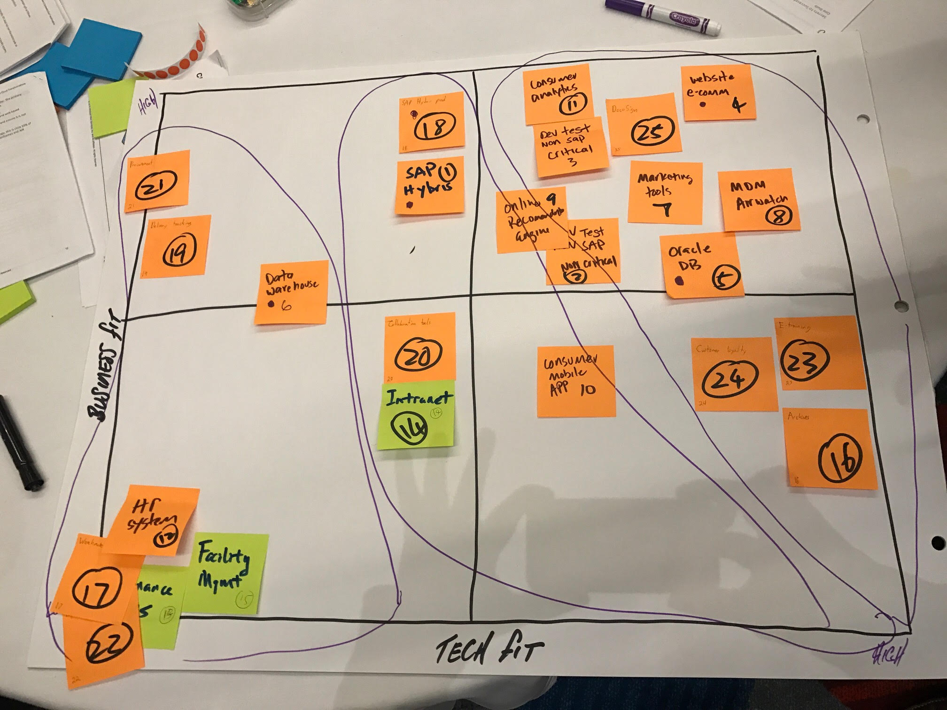
Activity Wrap Up

Slide 25
Module 2: Application Migrations

